Slide 1

<Autonomous car>
Omar Ashraf Abdelmawgoad

Slide 2
Components:
1. Ultrasonic HC- SR04.
2. Servo motor.
3. L293D.
4. 4WD RC CAR

Slide 3
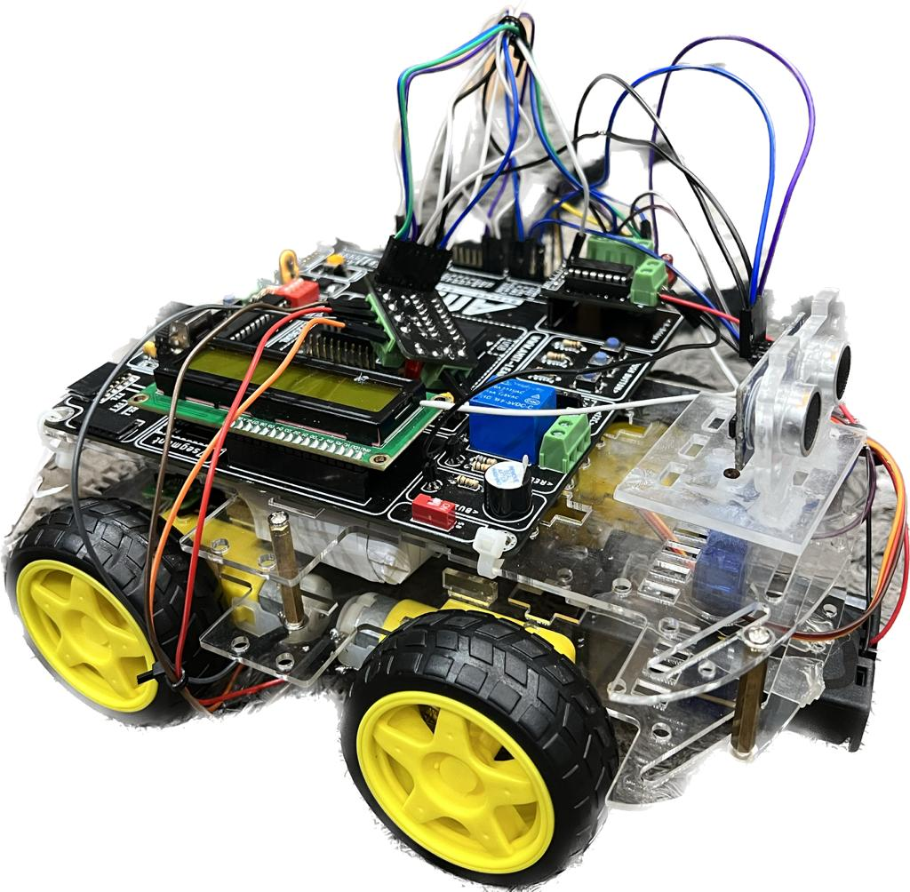
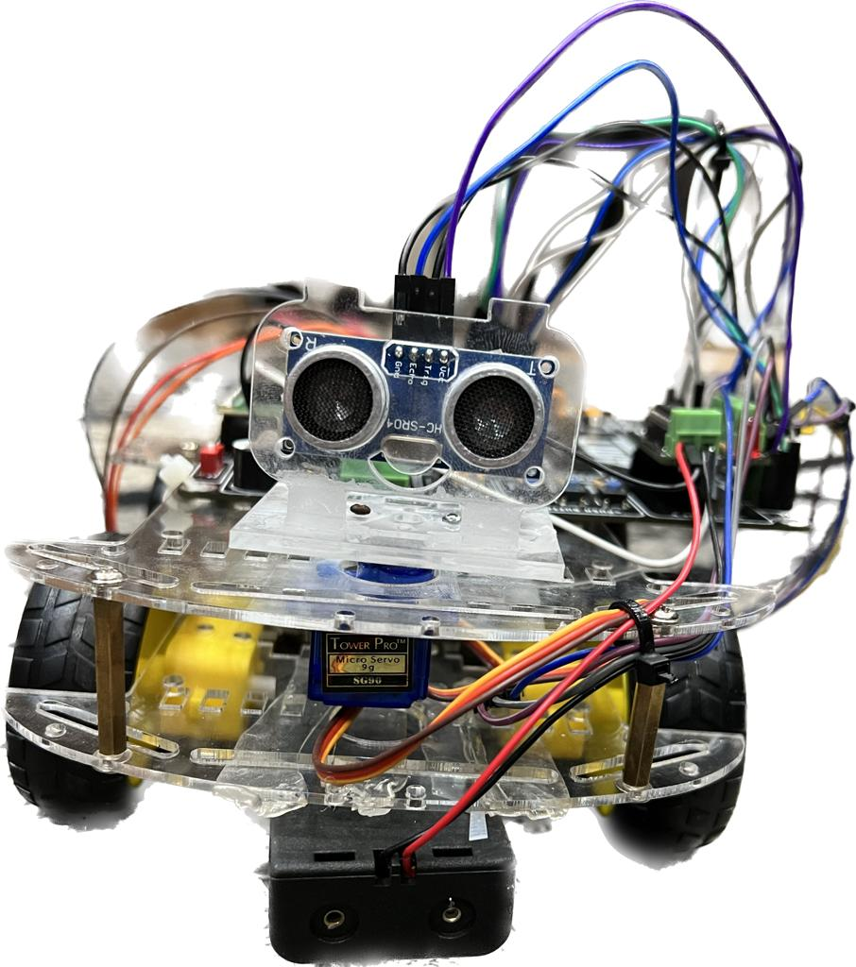
Project Photos:

Slide 4
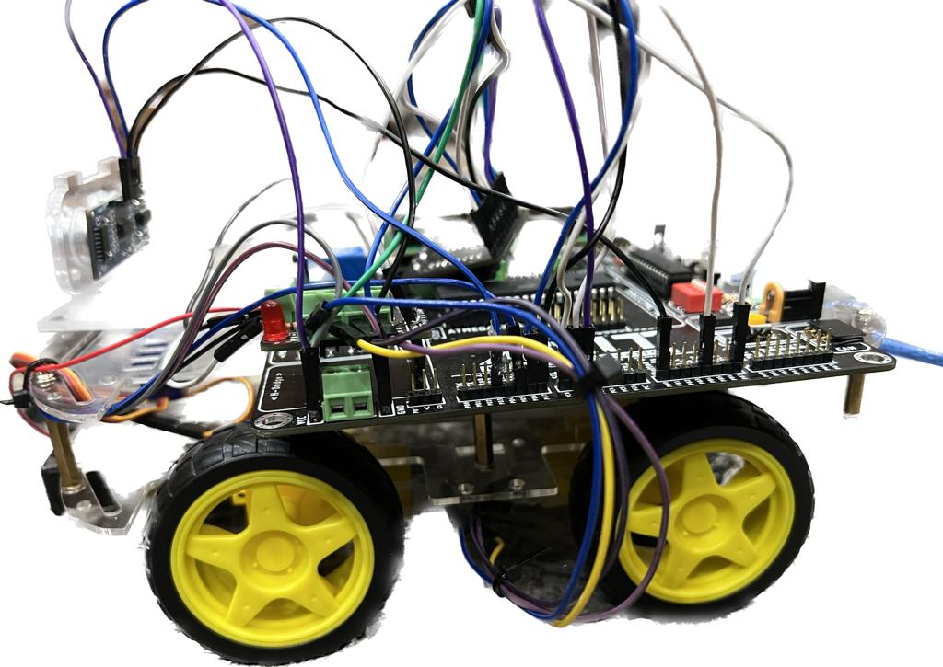
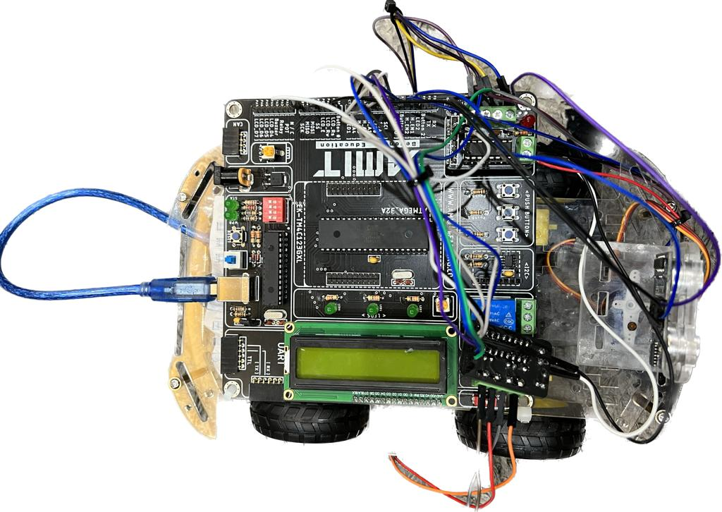
Additional photos:

Slide 5
WORK CONCEPT:
The car initially moves forward.
in case that obstacle is detected (measured distance less than 40cm) :
the servo motor moves left subsequently the ultrasonic measures the distance at the left of the car.
the servo motor moves right subsequently the ultrasonic measures the distance at the right of the car.
The car compares the two measured distances:
in case the left distance is greater than right distance:
the robot moves left and then forward [the direction will be displayed on the lcd].
in case the right distance is greater than left distance:
the robot moves right and then forward [the direction will be displayed on the lcd].
in case both direction are less than 40 the robot moves back and then measures right and left distances once more :
if right or left distances are > 40 the robot will compare the distances and chose the further distance .
Else the robot will move back and evaluate the distance and the loop continues till one of the distances is > 40 cm.

Slide 6
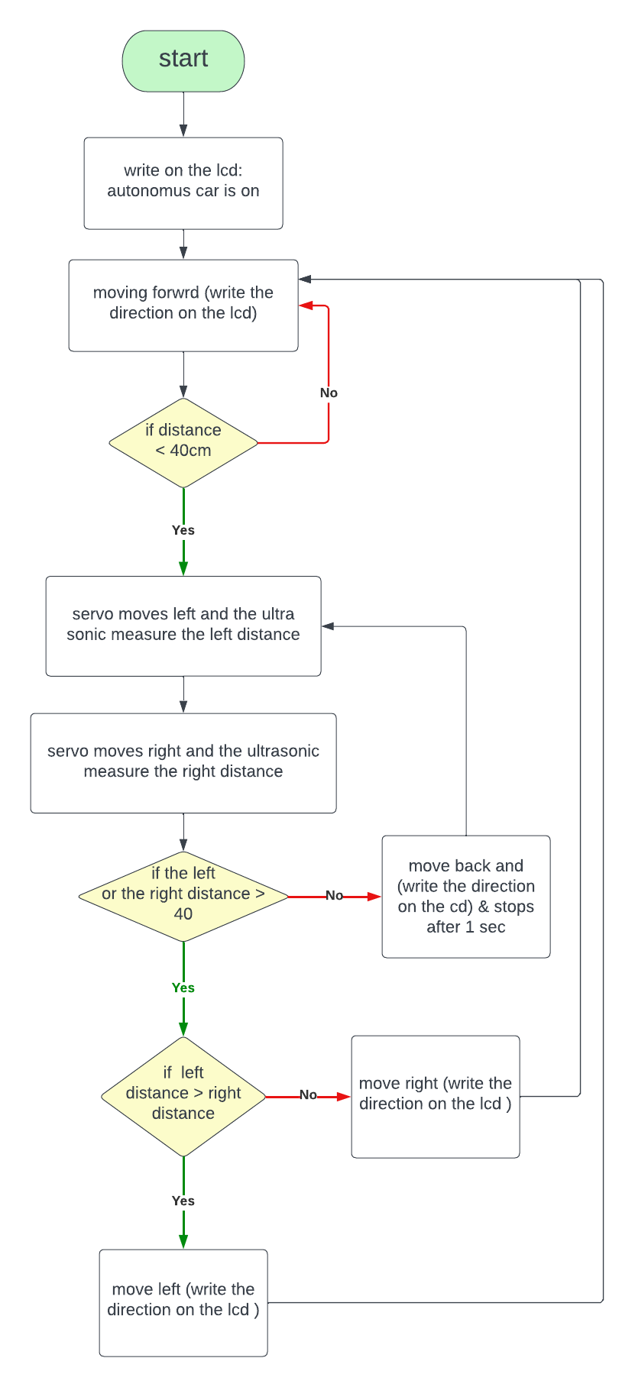
Flow chart:

Slide 7
GitHub link:
https://github.com/khaledshamndy/Autonomus-Car

